Slide 1
Blacktown Chinese Christian Church
Welcome to Our English Service 03.11.2024
English Service 9:45 – 11:00 am
Worship Songs: Passage: Speaker: Topic: Response Song: Announcements and Closing Prayer Benediction
This I Believe Blessed Assurance (CityAlight) What A Beautiful Name John 17:21 TBA TBA TBA

Slide 2
BCCC english service

Slide 3

Please keep all phones on silent

Slide 4
This I Believe
Ben Fielding, Matt Crocker © 2014 Hillsong Music Publishing Australia CCLI Licence No. 5485849 . CCLI Song number: 7018338

Slide 5
Verse 1
Our Father everlasting
The all-creating One
God Almighty

Slide 6
Verse 1
Through your Holy Spirit
Conceiving Christ the Son
Jesus our Saviour

Slide 7
Chorus
I believe in God our Father
I believe in Christ the Son
I believe in the Holy Spirit
Our God is three in One

Slide 8
Chorus
I believe in the resurrection
That we will rise again
For I believe in the Name of Jesus

Slide 9
Verse 2
Our Judge and our Defender
Suffered and crucified
Forgiveness is in You

Slide 10
Verse 2
Descended into darkness
You rose in glorious light
Forever seated high

Slide 11
Chorus
I believe in God our Father
I believe in Christ the Son
I believe in the Holy Spirit
Our God is three in One

Slide 12
Chorus
I believe in the resurrection
That we will rise again
For I believe in the Name of Jesus

Slide 13
Bridge 1
I believe in You
I believe You rose again
I believe that Jesus Christ is Lord
(x2)

Slide 14
Chorus 2
I believe in life eternal
I believe in the virgin birth
I believe in the saints' communion
And in Your Holy Church

Slide 15
Chorus 2
I believe in the resurrection
When Jesus comes again
For I believe in the Name of Jesus

Slide 16
Chorus
I believe in God our Father
I believe in Christ the Son
I believe in the Holy Spirit
Our God is three in One

Slide 17
Chorus
I believe in the resurrection
That we will rise again
For I believe in the Name of Jesus

Slide 18
Tag
For I believe in the Name of Jesus
For I believe in the Name of Jesus

Slide 19
Blessed Assurance
Jaywan Maxwell, Michael Farren, Nathan Singh, Rhyan Shirley ©2016 CityAlight Music (Admin. by Integrity Music) CCLI Licence No. 5485849. CCLI Song number: 22324

Slide 20
Verse 1
All my attempts to be satisfied were vain and empty
Until the moment You rescued me and Your love filled me
My soul sings
Now my soul sings

Slide 21
Chorus
What blessed assurance
I've found in You, I've found in You
I won't be shaken, I will not be moved

Slide 22
Chorus
How steadfast Your strong hand
Is keeping me, is keeping me
I won't be shaken, I will not be moved
O blessed assurance

Slide 23
Verse 2
No other love that I've ever known
Compares to You, God
No other love that I've ever found
Has done what You've done

Slide 24
Verse 2
My soul sings
Now my soul sings

Slide 25
Chorus
What blessed assurance
I've found in You, I've found in You
I won't be shaken, I will not be moved

Slide 26
Chorus
How steadfast Your strong hand
Is keeping me, is keeping me
I won't be shaken, I will not be moved
O blessed assurance

Slide 27
Bridge
Ever my anchor, ever my strength
Ever my portion, and all I need

Slide 28
Bridge
Ever my healing, ever my hope
Ever the truth that leads me home
That leads me home

Slide 29
Chorus
What blessed assurance
I've found in You, I've found in You
I won't be shaken, I will not be moved

Slide 30
Chorus
How steadfast Your strong hand
Is keeping me, is keeping me
I won't be shaken, I will not be moved
O blessed assurance

Slide 31
What A Beautiful Name
Ben Fielding, Brooke Ligertwood © 2016 Hillsong Music Publishing Australia CCLI Licence No. 5485849 . CCLI Song number: 7068424

Slide 32
Verse 1
You were the Word at the beginning
One with God the Lord Most High
Your hidden glory in creation
Now revealed in You our Christ

Slide 33
Chorus 1
What a beautiful Name it is
What a beautiful Name it is
The Name of Jesus Christ my King

Slide 34
Chorus 1
What a beautiful Name it is
Nothing compares to this
What a beautiful Name it is
The Name of Jesus

Slide 35
Verse 2
You didn't want heaven without us
So Jesus You brought heaven down
My sin was great Your love was greater
What could separate us now?

Slide 36
Chorus 2
What a wonderful Name it is
What a wonderful Name it is
The Name of Jesus Christ my King

Slide 37
Chorus 2
What a wonderful Name it is
Nothing compares to this
What a wonderful Name it is
The Name of Jesus

Slide 38
Chorus 2
What a wonderful Name it is
The Name of Jesus

Slide 39
Bridge
Death could not hold You
The veil tore before You
You silenced the boast of sin and grave

Slide 40
Bridge
The heavens are roaring
The praise of Your glory
For You are raised to life again

Slide 41
Bridge
You have no rival
You have no equal
Now and forever God You reign

Slide 42
Bridge
Yours is the Kingdom
Yours is the glory
Yours is the Name above all names

Slide 43
Chorus
What a powerful Name it is
What a powerful Name it is
The Name of Jesus Christ my King

Slide 44
Chorus
What a powerful Name it is
Nothing can stand against
What a powerful Name it is
The Name of Jesus

Slide 45
Tag
What a powerful Name it is
The Name of Jesus
What a powerful Name it is
The Name of Jesus

Slide 46
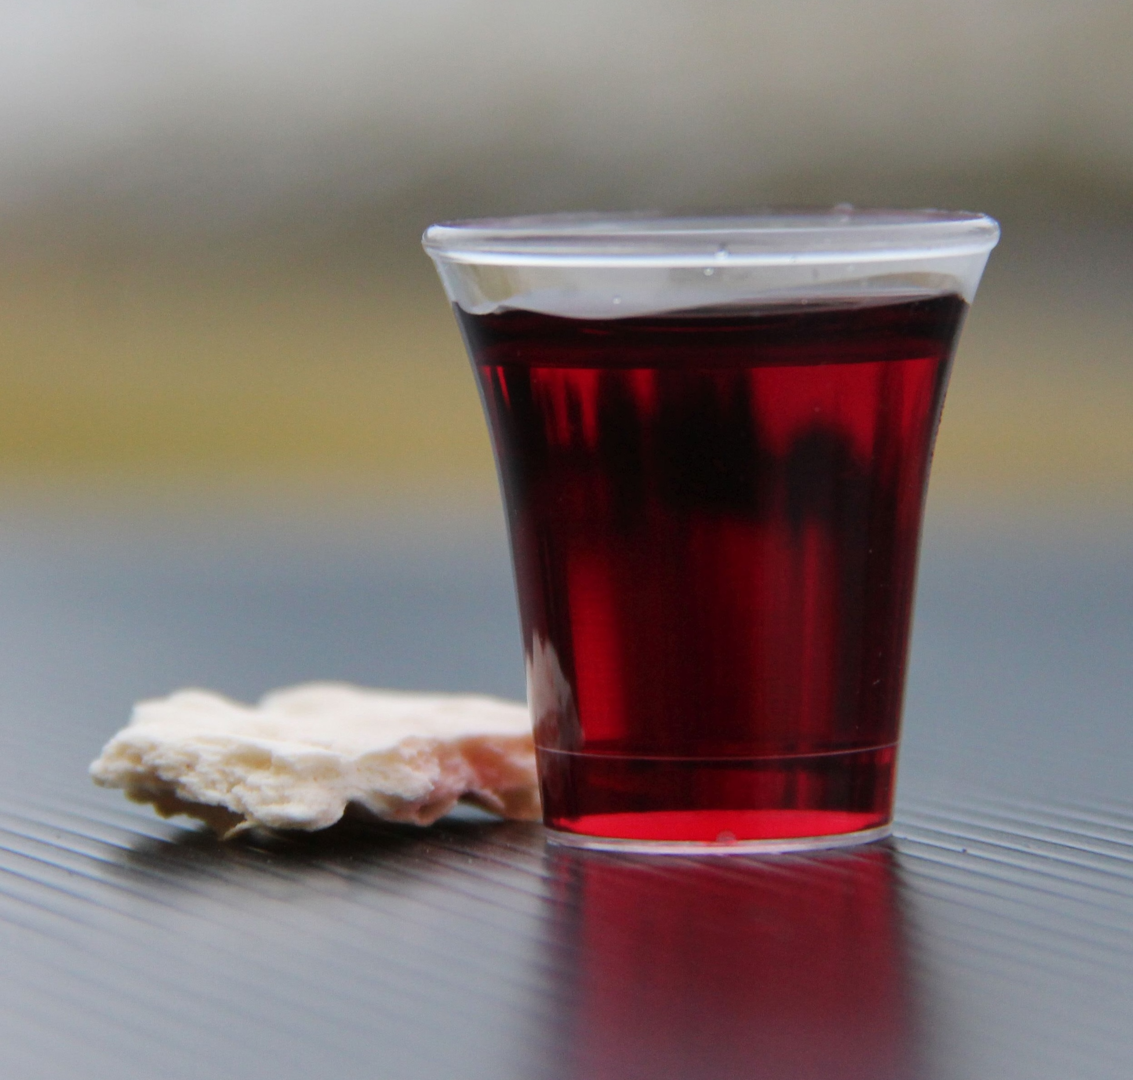
Holy Communion

Slide 47

Bible reading

Slide 48
Bible reading: John 17:21
²¹ that all of them may be one, Father, just as you are in me and I am in you. May they also be in us so that the world may believe that you have sent me.

Slide 49
Announcements

Slide 50





Account name: Blacktown Chinese Christian Church
Account number: 4216 50263
Offering
BSB: 112 - 879
Please put in "offering" as the reference
The offering box is available at the back of the hall

Slide 51
Prayer points

Slide 52
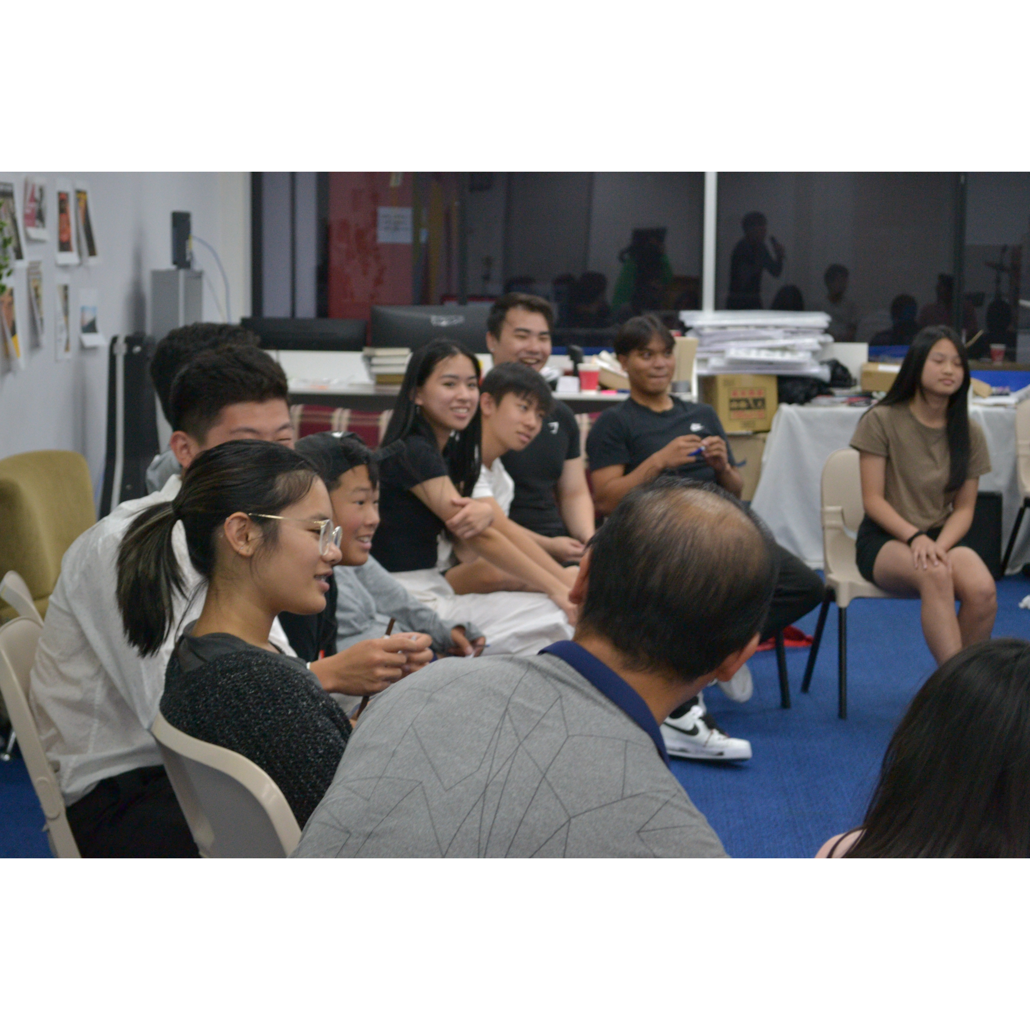
Mingle time!

